Slide 1
Introduction to Java
Hello, World!

Slide 2
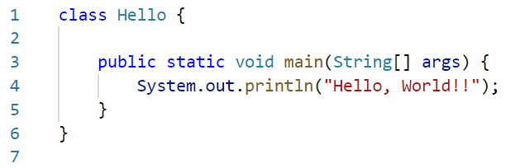
How Java works
Hello.java
Hello.class
javac Hello.java
Source code
Compiler
Byte code

Slide 3
How Java works

Slide 4
How Java works
Java Virtual Machine
JVM for Windows
Hello.class
Hello, world!!
java Hello
Byte code
Interpreter
Output

Slide 5
How Java works

Slide 6
How Java works
Compile and run using command line
javac Hello.java
java Hello

Slide 7
How Java works
JVM for Windows
JVM for
OS-X
JVM for Windows
JVM for Linux
Hello.class
Hello, world!!
java Hello
Byte code
Interpreter
Output

Slide 8
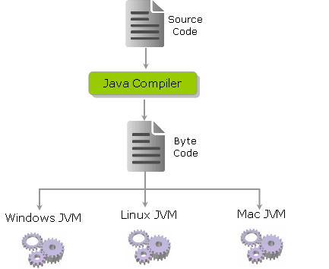
Java features
Java – Write Once Run Anywhere (WORA)
Java – Compiled and Interpreted
Java – Language as well as a platform
Java – programming needs JDK + JRE
Java Development Kit
JVM for Windows
JVM for Linux
JVM for OS-X
Java Runtime Environment
Windows
Linux
OS-X
Credit https://codingfox.com/0-6-java-as-a-platform-independent-language/

